Slide 1





Towards a sustainability process for
GEOSS Essential Variables
11-12 June 2015, Bari-Italy
Societal Benefit Area: Biodiversity
Name: Jörg Freyhof
Institution: iDiv/GEO BON
Coordinating an Observation Network of Networks Encompassing satellite and In-situ to fill the Gaps in European Observations
YOUR LOGO

Slide 2
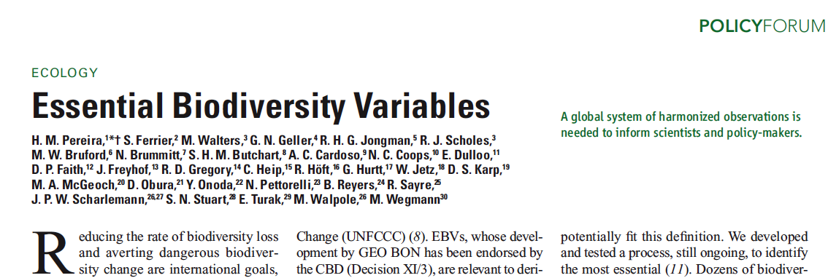


What is essential?
Essential is what needs to be monitored to describe and analyse the different dimensions of biodiversity change

Slide 3
What is an Essential Biodiversity Variable?
Scenarios
Indicators
EBVs
Raw data
Notes:
The idea behind this diagram is that at the bottom we have raw data represented by primary biodiv. obs. collected from in-situ & remote sensors
---The 1st level of abstraction between raw data & high-level indicators are the EBVs.
---Then EBVs can be synthetized into a 2nd level of abstraction such as the CBD indicators
---And finally these indicators once integrated with the different scenarios of pressures & responses can also be applied to make predictions
++However to understand better what exactly are EBVs, I need to to go back in time and explain what are the Essential Climatic Variables

Slide 4


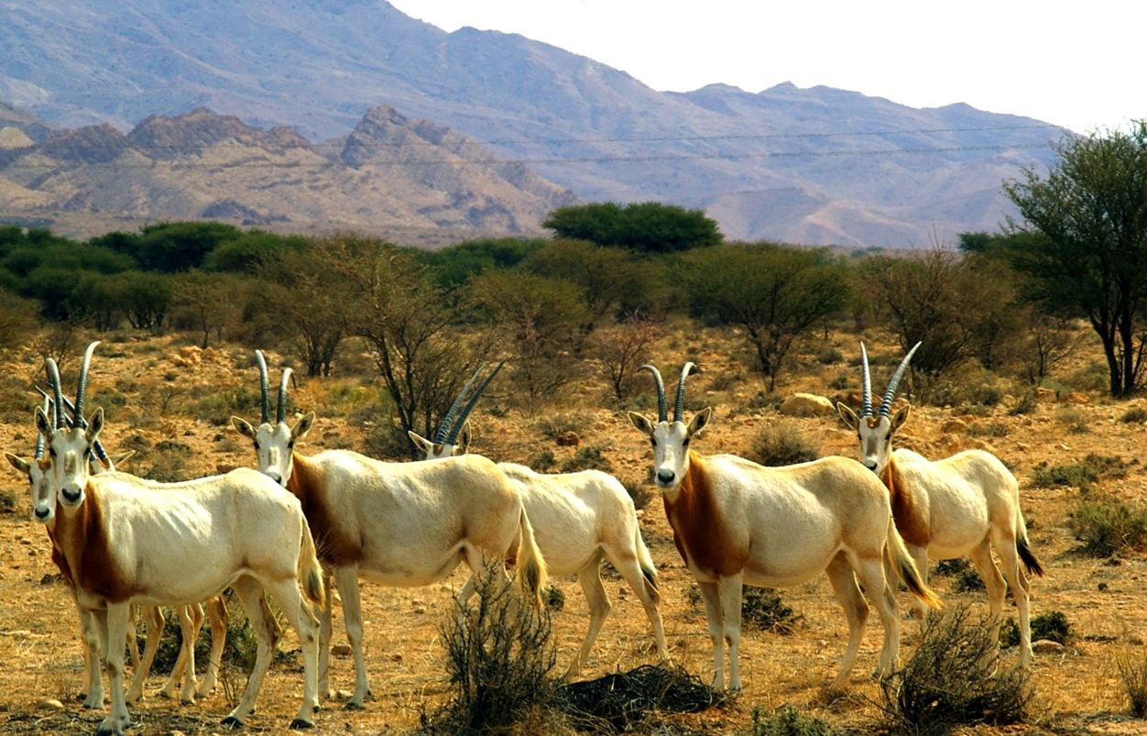


CBD, IPBES, RAMSAR, Convention on migratory species, governments and others need comprehensive and scientifically sound data and data products on biodiversity and ecosystem service status and change

Slide 5
Pereira, H.M. et al (2013) Science
Notes:
This figure is from the 2013 Science Paper that provides some examples of potential EBVs
Lets imagine for a moment that we want to address the issue of species population abundances

Slide 6
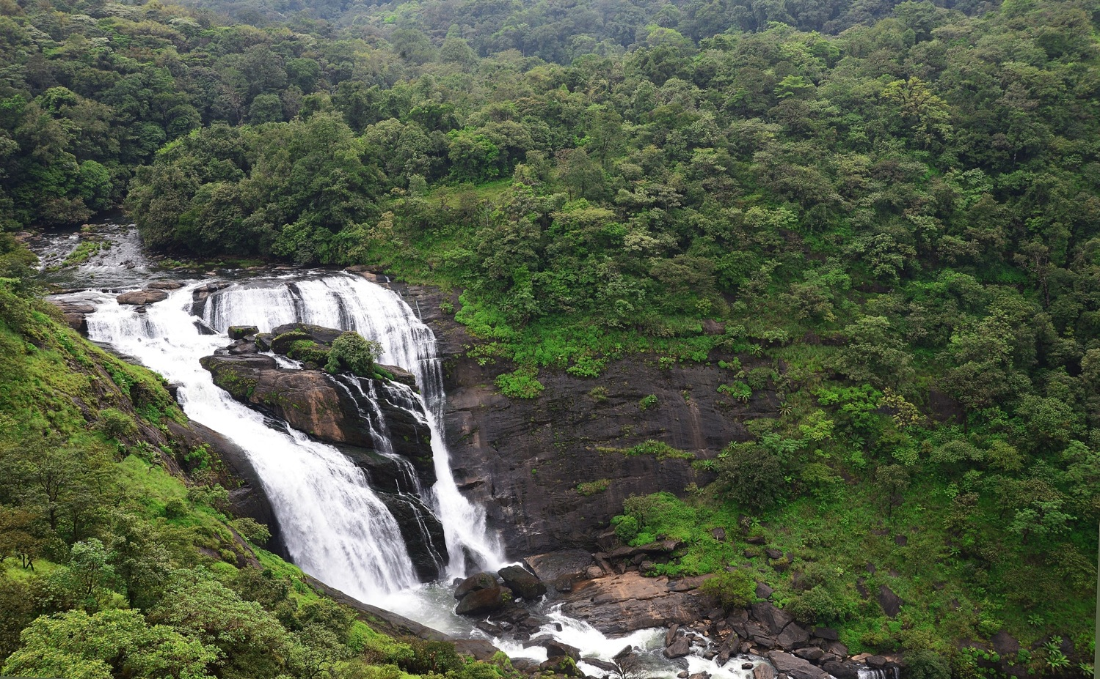
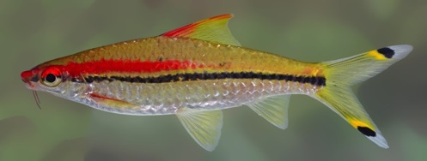

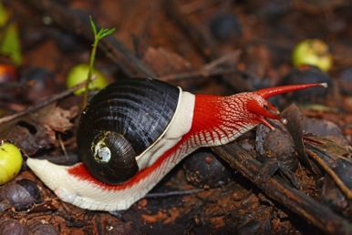
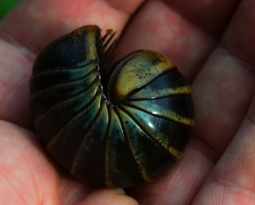

EBV’s: Monitoring the different dimensions of biodiversity change
Genetic composition
Ecosystem structure + function
Species population
Community composition
Traits

Slide 7
Essential biodiversity variables
Characteristics of EBV’s
  Ability to detect change
  Quantifiable
  Repeatable
  Allow aggregation and disaggregation
  Biological
  Drivers of change are no EBVs

Slide 8
Notes:
This conceptual diagram demonstrate how we should prioritize the development of EBV

Slide 9
EBVs 2015
Very high community acceptance
Existing projects adopt the concept
New projects funded to develop EVBs
National and regional partners adopt already EBV
concept to structure their monitoring data
Step by step focus on very specific key questions

Slide 10











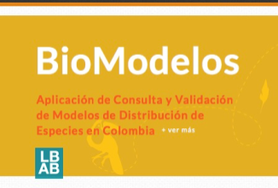









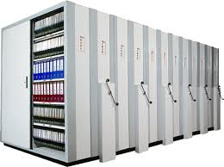


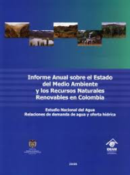

GEO BON set up BON in a Box

Slide 11

Status of existing EVs in the domain
  How do you define EBVs?
Metrics required to evaluate, report about, and manage the rate, magnitude and direction of biodiversity change at multiple scales (e.g., local to regional, to global) for the essential dimensions of biodiversity.
Is your community developing a set of area-specific EBVs?
The EBVs respond to the information needs of countries and national data are the building blocks of some EBVs. Generally, EBVs will be developed at the global scale from harmonized regional/national sub-units
If not, is the community planning to start this in the near future?
This will be a common approach as countries have little interest in the global scale and our engagement with BON in a Box will lead to more national engagements
  Have you attended previous meeting? No
  Are you considering reference documents from other domains? No

Slide 12
The process underlying EV definition
What criteria, methodology, and process are used to identify EBVs?
  Bottom-up & Top-down: A first set of EBVs have been published 2013.
      Conceptual definition
      Measurement strategy
      Feasibility and scalability
      Constraints and sensitivity
      Spatial coverage
      Temporal sustainability and periodicity
      Degree of consensus among the community
      Coherence and flows of input data
      Degree of abstraction in the methods and interpretation
      Proof of concept availability
      Opportunities for semi or full automation using new technology
      Documentation and guidelines
      Data management, archive and distribution
      QC&QA practices
      Relevancy and satisfaction of multiple user needs
      Stage of development
      Existing data availability

Slide 13
      Conceptual definition
      Measurement strategy
      Feasibility and scalability
      Constraints and sensitivity
      Spatial coverage
      Temporal sustainability and periodicity
      Degree of consensus among the community
      Coherence and flows of input data
      Degree of abstraction in the methods and interpretation
      Proof of concept availability
      Opportunities for semi or full automation using new technology
      Documentation and guidelines
      Data management, archive and distribution
      QC&QA practices
      Relevancy and satisfaction of multiple user needs
      Stage of development
      Existing data availability

Slide 14
Do you have a template to document EBVs?
 | Priority | Feasibility | Implementation | Status |  | Historical availibility | Current feasibility | Future feasibility | high spatial resolution required | Spectral | Temporal | Accuracy | Scalability | Accessibility | Future proof | Data manager | Data center | State | Driver | Biological | Unit | Grouping | Data source | Sensitivity | Acceptance level (by users) | Coherence/flows of input data | Degree of abstraction | Proof of concept | Maturity of Methodology | QC and QA | Stage of development | Data availibility
Biomass | 1 | 2 | 2 | 2
Canopy cover | 1 | 2 | 2 | 2
canopy moisture content
Cover (fraction) | @
Disturbance
FAPAR | 1 | 1 | 1 | 2
forest change detection | @
fragmentation | 1 | 1 | 2 | 2
greening
Habitat (extent)
Habitat change
Habitat structure
Height | 1 | 2 | 3 | 3
invasive species | @
LAI
Land cover
Life forms (grass, herbs, shrubs, etc.)
NDVI, PV, soil | 1 | 1 | 1 | 1
NPP
patches
Phenology
Plant traits (e.g. chlorophyll)
Plant traits foliar N content
senescence
shapes for disturbed forests
Soil traits | x
spatial metrics | @
Species composition
Species diversity | 1 | 2 | 3 | 3
species richness | 1 | 2 | 2 | 2
species traits
Specific leaf area
successional stage
Vegetation types
Water inundation | x

Slide 15
EVs validation and use
To what extent EBVs (if any) are validated and used
To be validated EBVs need to be measured, digitized, mobilized and finally made freely and openly available, a process just having started.
Are the EBVs linked to applications and users? Yes
Who the users are?
Absolutely. Major users are the CBD, IPBES, governments and scientists
How is a community agreement reached?
By the “Call for EBV developers” our goal is to start the dialogue to reach consensus among the community.

Slide 16
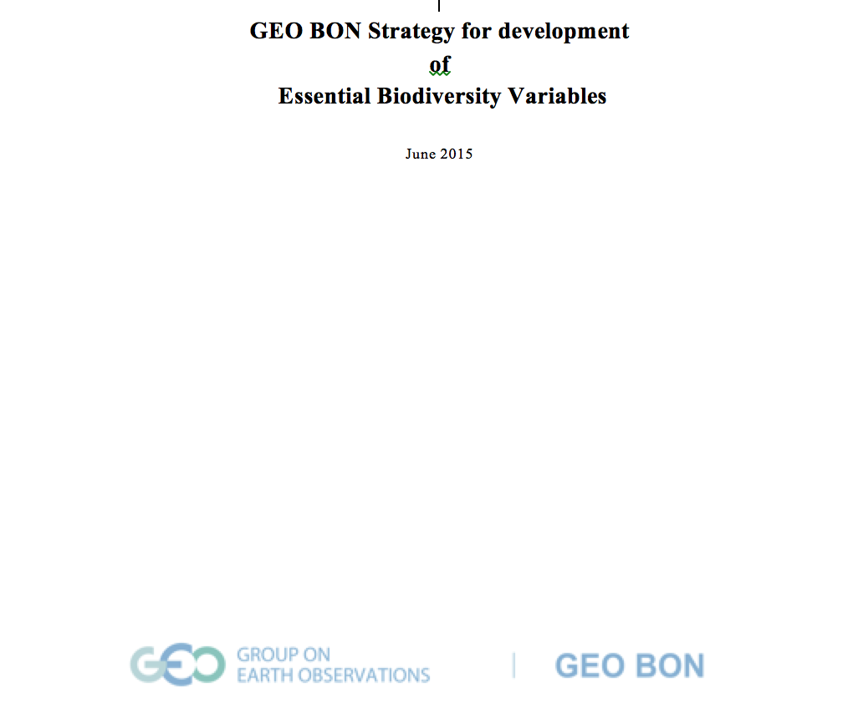
GEO BON Strategy for development
of
Essential Biodiversity Variables
June 2015

Slide 17
EVs validation and use
Is a community review process in place?
  Not yet, but we plan to have an internal review process once we launch the call for EBV developers.
Are the EBVs linked to an international body (i.e. a UN convention or similar) and is this body involved in accepting the EBVs?
  Yes: They are closely linked to CBD Aichi Targets

Slide 18
Describing the monitoring networks currently operational
Do you have a database with information on the EBVs?
  Yes, there are multiple databases that have different types of data that can be used towards EBV development as GBIF, LTER, GLORIA, etc.
Do you know networks currently operational for medium-term/long-term monitoring?
  Yes, there are many
Are the current operational networks operated by your community measuring the EBVs?
  Partly yes. Some networks and regions have adopted the EBV concept to measure regional biodiversity. We have initiated a program that has as a goal to promote the development of national level biodiversity observation networks, where the EBV is used as the main framework that will guide these initiatives.

Slide 19
Assessing EV observational needs and readiness
For some Use Case, have you already focused on EBVs’ features:
  Temporal frequency
  Spatial resolution
  Accuracy
  etc.;
Challenges and how these are addressed (if any)

Slide 20

The Gollum effect
My Precious Data!
Mine!
My Knowledge!
My Expertise!
I will never give it away
Slide by Patricia Mergen (TDWG 2014). Need for Controlled Vocabularies on Intellectual Property Right statements?
http://lotr.wikia.com/wiki/Gollum
http://www.tdwg.org/fileadmin/2014conference/slides/Mergen_Controlled_Vocabularies_for_IPR.pptx

Slide 21
Gaps and requirements
Have you already carried out a gap analysis utilizing the EBVs to identify gaps and priorities in terms of:
  EO data availability
  In-situ data availability
  Models (algorithms) for EBV extraction: direct measurements or proxies
  Data repositories for the long term preservation of EBVs
  Infrastructure for EBVs publication
  This has been in depth discussed when proposing the EBVs. The Dashboard of indicators will promote the development of EBV and will be used to asses priorities and gaps.

Slide 22
Conclusions
Overlapping with EVs in other domains (SBA)
Many users ask for drivers of biodiversity change as EBVs and we would like to link these closely
Priorities for EBVs operational monitoring
Recommendations for GEO/GEOSS
Future work

